Slide 1
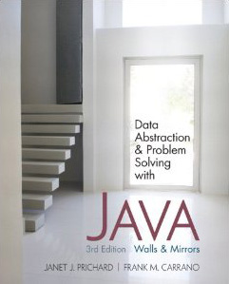
Chapter 4
Data Abstraction: The Walls
© 2011 Pearson Addison-Wesley. All rights reserved
4-<number>

Slide 2
Abstract Data Types
Modularity
  Keeps the complexity of a large program manageable by systematically controlling the interaction of its components
  Isolates errors
  Eliminates redundancies
  A modular program is
    Easier to write
    Easier to read
    Easier to modify
© 2011 Pearson Addison-Wesley. All rights reserved
4-<number>

Slide 3
Abstract Data Types
Procedural abstraction
  Separates the purpose and use of a module from its implementation
  A module’s specifications should
    Detail how the module behaves
    Identify details that can be hidden within the module
Information hiding
  Hides certain implementation details within a module
  Makes these details inaccessible from outside the module
© 2011 Pearson Addison-Wesley. All rights reserved
4-<number>

Slide 4
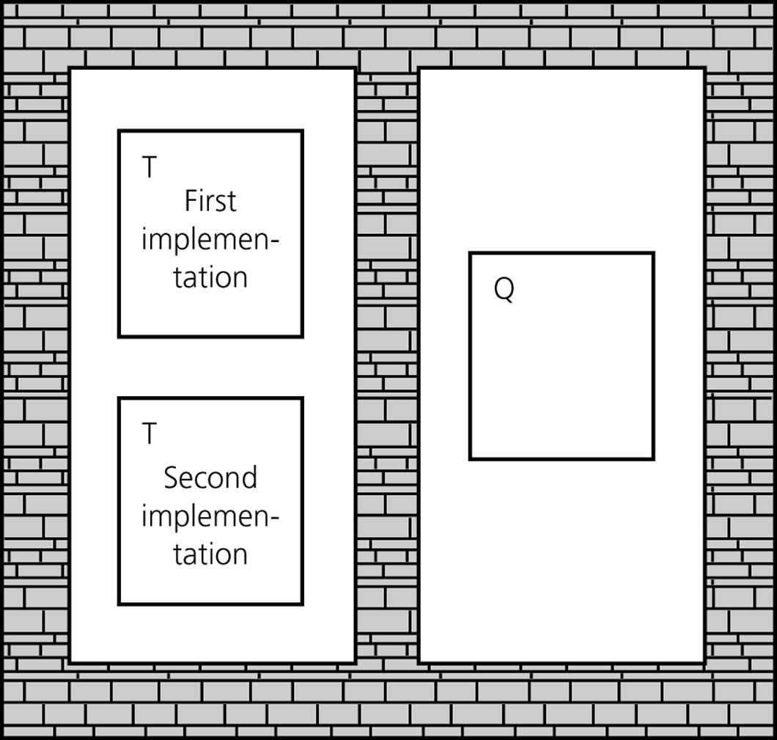
Abstract Data Types
Figure 4-1
Isolated tasks: the implementation of task T does not affect task Q
© 2011 Pearson Addison-Wesley. All rights reserved
4-<number>

Slide 5
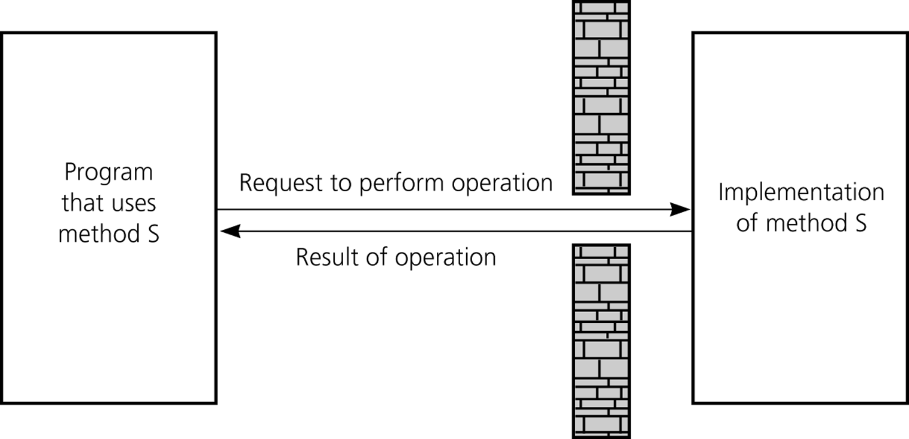
Abstract Data Types
The isolation of modules is not total
  Methods’ specifications, or contracts, govern how they interact with each other
Figure 4-2
A slit in the wall
© 2011 Pearson Addison-Wesley. All rights reserved
4-<number>

Slide 6
Abstract Data Types
Typical operations on data
  Add data to a data collection
  Remove data from a data collection
  Ask questions about the data in a data collection
Data abstraction
  Asks you to think what you can do to a collection of data independently of how you do it
  Allows you to develop each data structure in relative isolation from the rest of the solution
  A natural extension of procedural abstraction
© 2011 Pearson Addison-Wesley. All rights reserved
4-<number>

Slide 7
Abstract Data Types
Abstract data type (ADT)
  An ADT is composed of
    A collection of data
    A set of operations on that data
  Specifications of an ADT indicate
    What the ADT operations do, not how to implement them
  Implementation of an ADT
    Includes choosing a particular data structure
© 2011 Pearson Addison-Wesley. All rights reserved
4-<number>

Slide 8
Abstract Data Types
Data structure
  A construct that is defined within a programming language to store a collection of data
  Example: arrays
ADTs and data structures are not the same
Data abstraction
  Results in a wall of ADT operations between data structures and the program that accesses the data within these data structures
© 2011 Pearson Addison-Wesley. All rights reserved
4-<number>

Slide 9
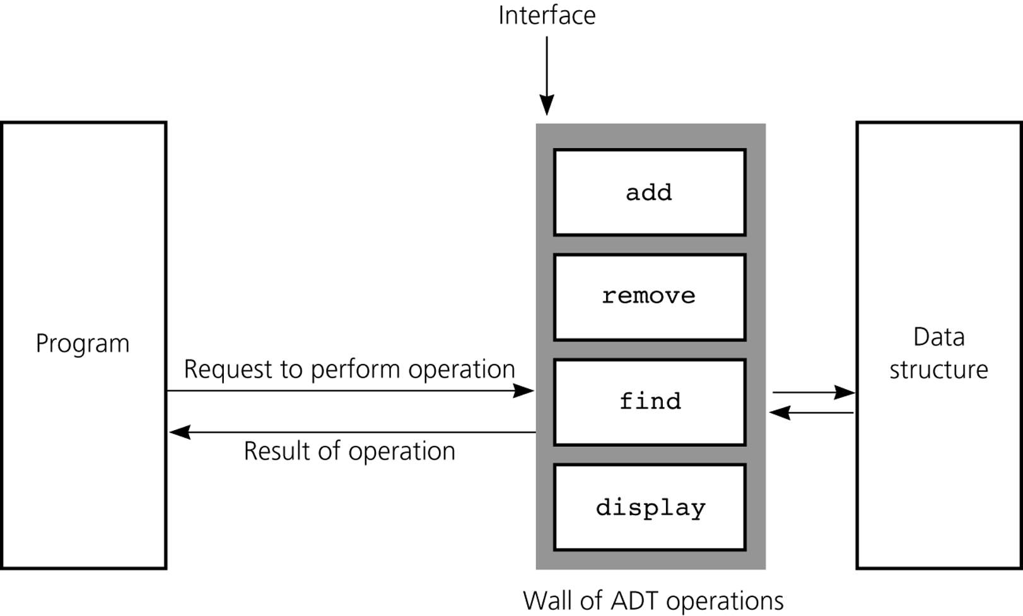
Abstract Data Types
Figure 4-4
A wall of ADT operations isolates a data structure from the program that uses it
© 2011 Pearson Addison-Wesley. All rights reserved
4-<number>

Slide 10
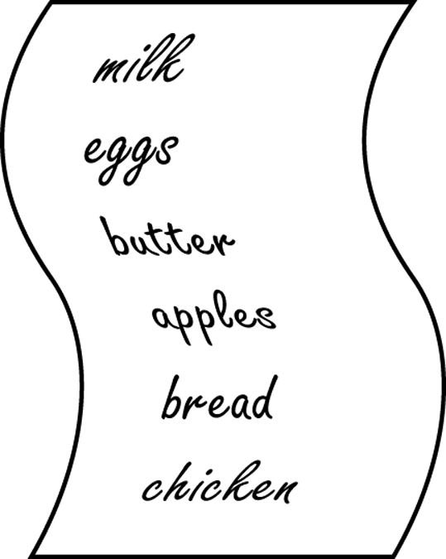
Specifying ADTs
In a list
  Except for the first and last items, each item has
    A unique predecessor
    A unique successor
  Head or front
    Does not have a predecessor
  Tail or end
    Does not have a successor
Figure 4-5
list A grocery
© 2011 Pearson Addison-Wesley. All rights reserved
4-<number>

Slide 11
The ADT List
ADT List operations
  Create an empty list
  Determine whether a list is empty
  Determine the number of items in a list
  Add an item at a given position in the list
  Remove the item at a given position in the list
  Remove all the items from the list
  Retrieve (get) the item at a given position in the list
Items are referenced by their position within the list
© 2011 Pearson Addison-Wesley. All rights reserved
4-<number>

Slide 12
The ADT List
Specifications of the ADT operations
  Define the contract for the ADT list
  Do not specify how to store the list or how to perform the operations
ADT operations can be used in an application without the knowledge of how the operations will be implemented
© 2011 Pearson Addison-Wesley. All rights reserved
4-<number>

Slide 13
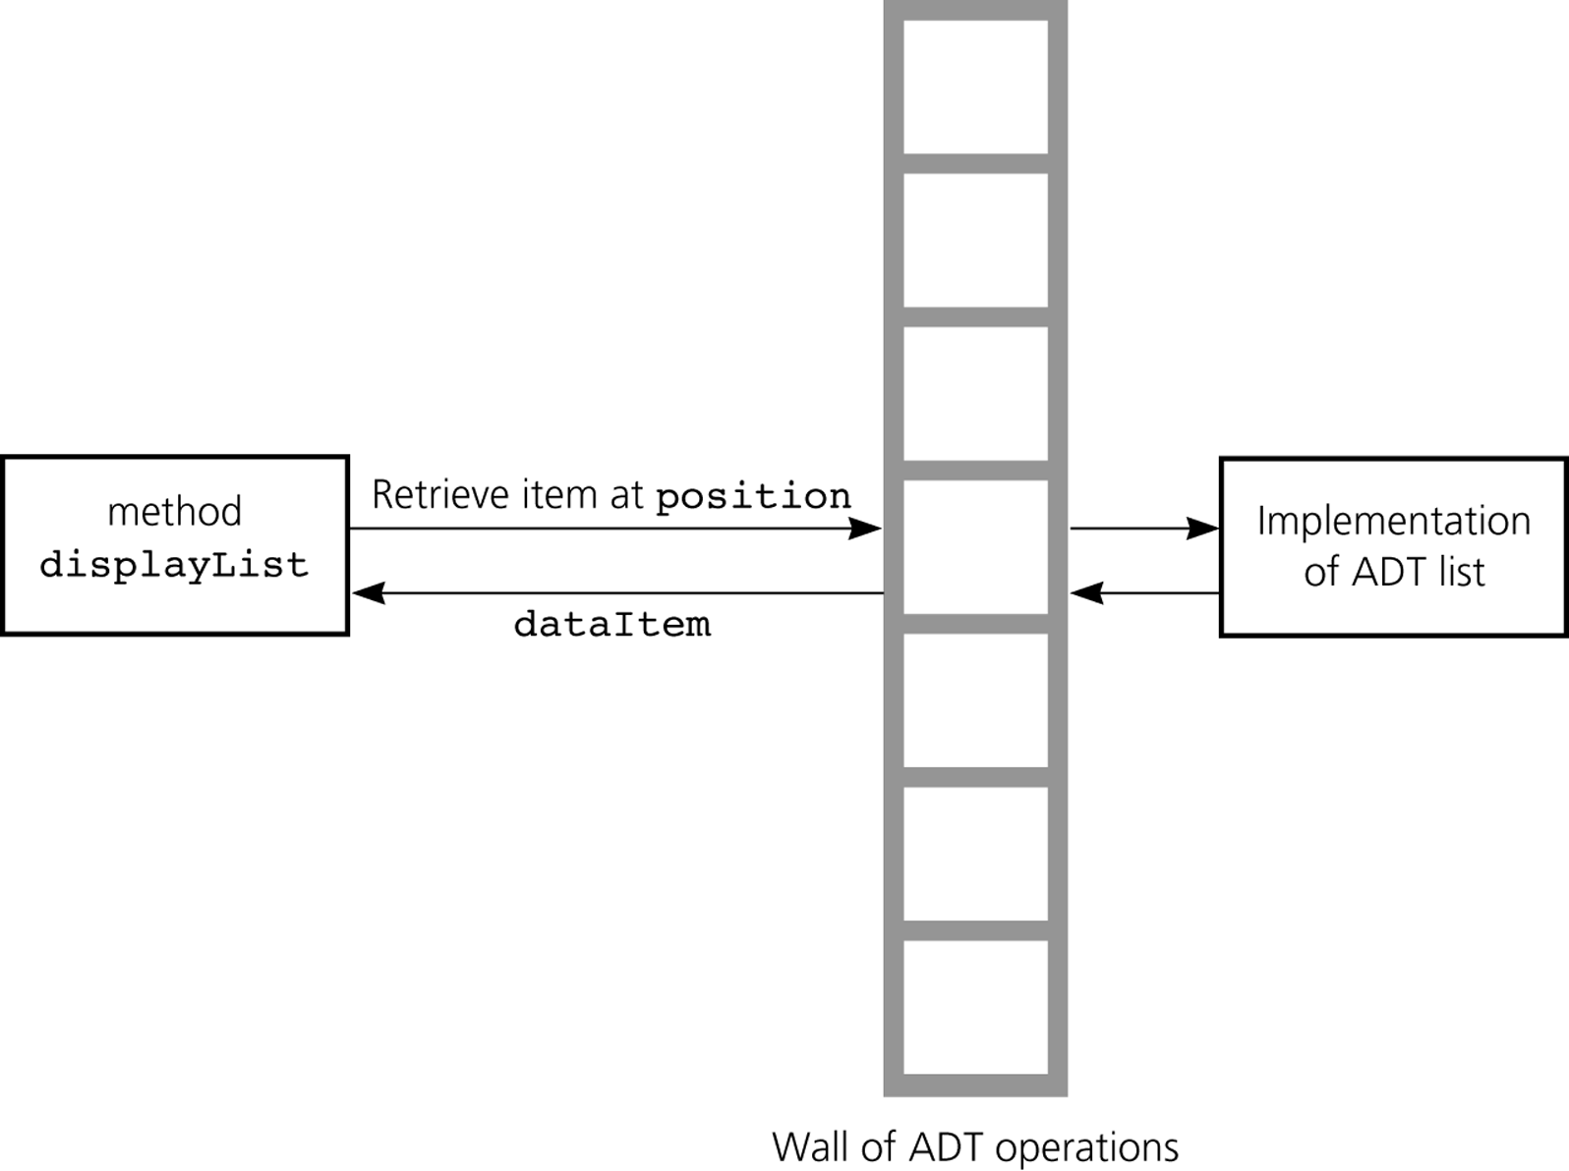
The ADT List
Figure 4-7
The wall between displayList and the implementation of the ADT list
© 2011 Pearson Addison-Wesley. All rights reserved
4-<number>

Slide 14
The ADT Sorted List
The ADT sorted list
  Maintains items in sorted order
  Inserts and deletes items by their values, not their positions
© 2011 Pearson Addison-Wesley. All rights reserved
4-<number>

Slide 15
Designing an ADT
The design of an ADT should evolve naturally during the problem-solving process
Questions to ask when designing an ADT
  What data does a problem require?
  What operations does a problem require?
© 2011 Pearson Addison-Wesley. All rights reserved
4-<number>

Slide 16
Axioms (Optional)
For complex abstract data types, the behavior of the operations must be specified using axioms
  Axiom: A mathematical rule
© 2011 Pearson Addison-Wesley. All rights reserved
4-<number>

Slide 17
Axioms (Optional)
Axioms for the ADT List
  (aList.createList()).size() = 0
  (aList.add(i, x)).size() = aList.size() + 1
  (aList.remove(i)).size() = aList.size() – 1
  (aList.createList()).isEmpty() = true
  (aList.add(i, item)).isEmpty() = false
  (aList.createList()).remove(i) = error
  (aList.add(i, x)).remove(i) = aList
  (aList.createList()).get(i) = error
  (aList.add(i, x)).get(i) = x
  aList.get(i) = (aList.add(i, x).get(i+1)
  aList.get(i+1) = (aList.remove(i)).get(i)
© 2011 Pearson Addison-Wesley. All rights reserved
4-<number>

Slide 18
Implementing ADTs
Choosing the data structure to represent the ADT’s data is a part of implementation
  Choice of a data structure depends on
    Details of the ADT’s operations
    Context in which the operations will be used
Implementation details should be hidden behind a wall of ADT operations
  A program would only be able to access the data structure using the ADT operations
© 2011 Pearson Addison-Wesley. All rights reserved
4-<number>

Slide 19
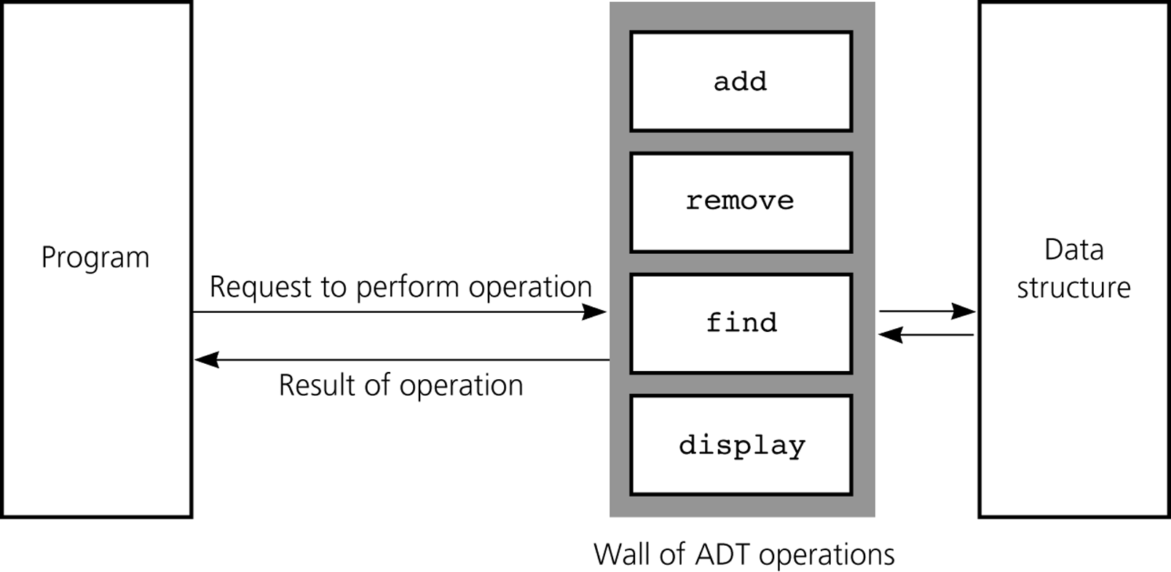
Implementing ADTs
Figure 4-8
ADT operations provide access to a data structure
© 2011 Pearson Addison-Wesley. All rights reserved
4-<number>

Slide 20
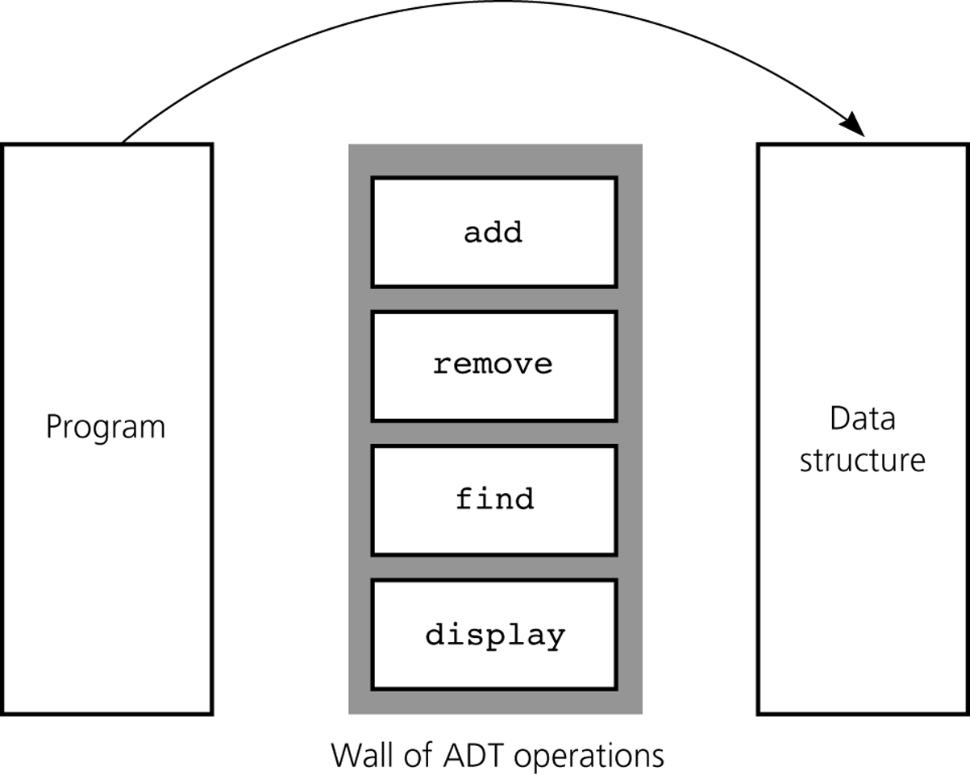
Implementing ADTs
Figure 4-9
Violating the wall of ADT operations
© 2011 Pearson Addison-Wesley. All rights reserved
4-<number>

Slide 21
Java Classes Revisited
Object-oriented programming (OOP) views a program as a collection of objects
Encapsulation
  A principle of OOP
  Can be used to enforce the walls of an ADT
  Combines an ADT’s data with its method to form an object
  Hides the implementation details of the ADT from the programmer who uses it
© 2011 Pearson Addison-Wesley. All rights reserved
4-<number>

Slide 22
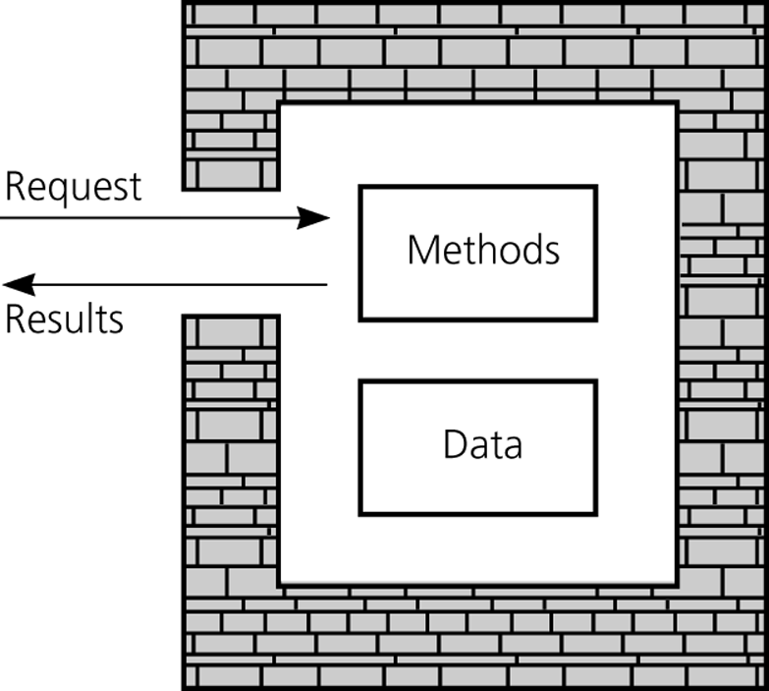
Java Classes Revisited
Figure 4-10
An object’s data and methods are encapsulated
© 2011 Pearson Addison-Wesley. All rights reserved
4-<number>

Slide 23
Java Classes Revisited
A Java class
  A new data type whose instances are objects
  Class members
    Data fields
      Should almost always be private
    Methods
  All members in a class are private, unless the programmer designates them as public
© 2011 Pearson Addison-Wesley. All rights reserved
4-<number>

Slide 24
Java Classes Revisited
A Java class (Continued)
  Constructor
    A method that creates and initializes new instances of a class
    Has the same name as the class
    Has no return type
  Java’s garbage collection mechanism
    Destroys objects that a program no longer references
© 2011 Pearson Addison-Wesley. All rights reserved
4-<number>

Slide 25
Java Classes Revisited
Constructors
  Allocate memory for an object and can initialize the object’s data
  A class can have more than one constructor
  Default constructor
    Has no parameters
    Typically, initializes data fields to values the class implementation chooses
© 2011 Pearson Addison-Wesley. All rights reserved
4-<number>

Slide 26
Java Classes Revisited
Constructors (Continued)
  Compiler-generated default constructor
    Generated by the compiler if no constructor is included in a class
Client of a class
  A program or module that uses the class
© 2011 Pearson Addison-Wesley. All rights reserved
4-<number>

Slide 27
Java Classes Revisited
Inheritance
  Base class or superclass
  Derived class or subclass
    Inherits the contents of the superclass
    Includes an extends clause that indicates the superclass
    super keyword
      Used in a constructor of a subclass to call the constructor of the superclass
© 2011 Pearson Addison-Wesley. All rights reserved
4-<number>

Slide 28
Java Classes Revisited
Object Equality
  equals method of the Object class
    Default implementation
      Compares two objects and returns true if they are actually the same object
    Customized implementation for a class
      Can be used to check the values contained in two objects for equality
© 2011 Pearson Addison-Wesley. All rights reserved
4-<number>

Slide 29
Java Interfaces
An interface
  Specifies methods and constants, but supplies no implementation details
  Can be used to specify some desired common behavior that may be useful over many different types of objects
  The Java API has many predefined interfaces
    Example: java.util.Collection
© 2011 Pearson Addison-Wesley. All rights reserved
4-<number>

Slide 30
Java Interfaces
A class that implements an interface must
  Include an implements clause
  Provide implementations of the methods of the interface
To define an interface
  Use the keyword interface instead of class in the header
  Provide only method specifications and constants in the interface definition
© 2011 Pearson Addison-Wesley. All rights reserved
4-<number>

Slide 31
Java Exceptions
Exception
  A mechanism for handling an error during execution
  A method indicates that an error has occurred by throwing an exception
© 2011 Pearson Addison-Wesley. All rights reserved
4-<number>

Slide 32
Java Exceptions
Catching exceptions
  try block
    A statement that might throw an exception is placed within a try block
    Syntax
      try {
      statement(s);
      } // end try
© 2011 Pearson Addison-Wesley. All rights reserved
4-<number>

Slide 33
Java Exceptions
Catching exceptions (Continued)
  catch block
    Used to catch an exception and deal with the error condition
    Syntax
      catch (exceptionClass identifier) {
      statement(s);
      } // end catch
© 2011 Pearson Addison-Wesley. All rights reserved
4-<number>

Slide 34
Java Exceptions
Types of exceptions
  Checked exceptions
    Instances of classes that are subclasses of the java.lang.Exception class
    Must be handled locally or explicitly thrown from the method
    Used in situations where the method has encountered a serious problem
© 2011 Pearson Addison-Wesley. All rights reserved
4-<number>

Slide 35
Java Exceptions
Types of exceptions (Continued)
  Runtime exceptions
    Used in situations where the error is not considered as serious
    Can often be prevented by fail-safe programming
    Instances of classes that are subclasses of the RuntimeException class
    Are not required to be caught locally or explicitly thrown again by the method
© 2011 Pearson Addison-Wesley. All rights reserved
4-<number>

Slide 36
Java Exceptions
Throwing exceptions
  A throw statement is used to throw an exception
    throw new exceptionClass (stringArgument);
Defining a new exception class
  A programmer can define a new exception class
© 2011 Pearson Addison-Wesley. All rights reserved
4-<number>

Slide 37
An Array-Based Implementation of the ADT List
An array-based implementation
  A list’s items are stored in an array items
  A natural choice
    Both an array and a list identify their items by number
  A list’s k^{th} item will be stored in items[k-1]
© 2011 Pearson Addison-Wesley. All rights reserved
4-<number>

Slide 38
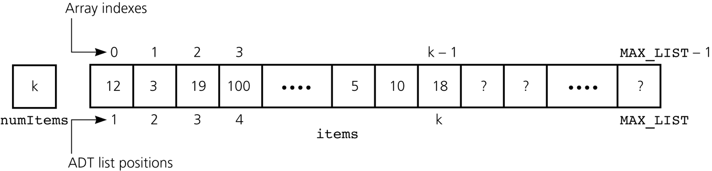
An Array-Based Implementation of the ADT List
Figure 4-11
An array-based implementation of the ADT list
© 2011 Pearson Addison-Wesley. All rights reserved
4-<number>

Slide 39
Summary
Data abstraction: a technique for controlling the interaction between a program and its data structures
An ADT: the specifications of a set of data management operations and the data values upon which they operate
The formal mathematical study of ADTs uses systems of axioms to specify the behavior of ADT operations
Only after you have fully defined an ADT should you think about how to implement it
© 2011 Pearson Addison-Wesley. All rights reserved
4-<number>

Slide 40
Summary
A client should only be able to access the data structure by using the ADT operations
An object encapsulates both data and operations on that data
  In Java, objects are instances of a class, which is a programmer-defined data type
A Java class contains at least one constructor, which is an initialization method
Typically, you should make the data fields of a class private and provide public methods to access some or all of the data fields
© 2011 Pearson Addison-Wesley. All rights reserved
4-<number>

